Slide 1


JOURNEY OF FLIGHT
Chapter 19
Weather Elements

Slide 2
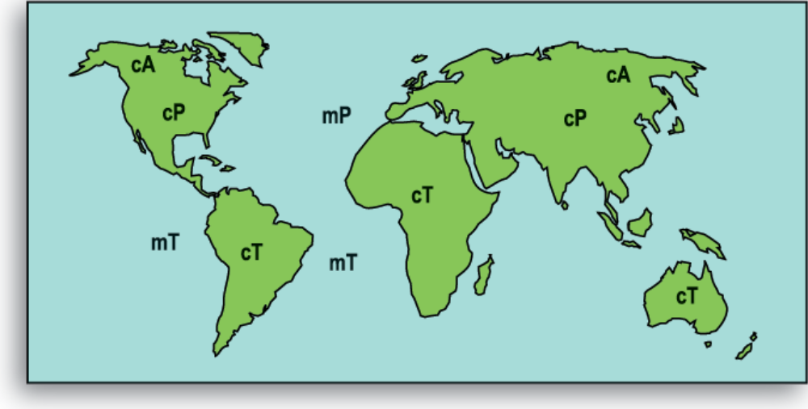
Notes:
Air Mass Type and Origination
A polar air mass (P) is cold and a tropical air mass (T) is hot. A maritime air mass (m) is humid and a continental air mass (c) is dry. Maritime air masses are formed over water and continental air masses are formed over land. Aviators and meteorologists in the United States are mainly concerned with two air masses — those that move southward from polar regions and those that move northward from tropical regions.
Here are the air mass classifications:
cA = continental arctic
cP = continental polar
cT = continental tropical
mT = maritime tropical
mP = maritime polar
mE = maritime equatorial

Slide 3
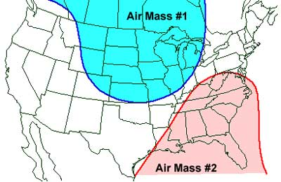
Weather Fronts and their Movement
Air Masses
Characteristics
  Over 1000 mi wide
  Same temperature and moisture content
  Origination determines type
Types
  Polar
  Tropical
  Maritime
  Continental
Notes:
Characteristics of Air Masses
The characteristics of an air mass depend on four things: the surface over which it forms, the season, the surface over which it travels and the length of time it has been away from its source. The general movement of the atmosphere across the United States is toward the east. Air masses originating in the tropical and equatorial areas move toward the northeast. Those originating in the arctic and polar areas move toward the southeast. Cold air masses move more rapidly than warm air masses. The weather generally depends on the nature or origin of an air mass or the interaction of two or more air masses. As an air mass moves away from its source, its original characteristics are changed by the earth’s surface over which it passes. It may become warmer or colder, absorb or lose moisture, rise over mountains or settle into valleys. However, an air mass is not likely to lose all of its original characteristics.

Slide 4
Fronts and their Movement
Fronts
  Cold front
  Warm front
  Stationary front
  Occluded front
Clouds
  Cumulus
  Cirrus
  Stratus
  Nimbo
  Alto
Fronts – boundaries between air masses
What is a warm front?
What does it look like?
Notes:
Fronts
The boundaries between air masses of different characteristics are called frontal zones or fronts. A front moves along the earth’s surface as one air mass displaces another. If a cold air mass replaces a warmer air mass, the boundary is called a cold front. If a warm air mass replaces a cold air mass, the boundary is called a warm front. When there is a big temperature and humidity difference between the two air masses, weather changes along the front will be severe.

Slide 5
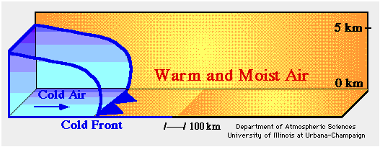
Fronts and their Movement
Cold Front
Hint: Looks like little icicles on a string.
Notes:
Cold Front. The cold front’s general direction of travel across the United States is from the northwest to southeast. Cold fronts travel very far south, even in the summertime. The energy of a cold front depends on the amount of cold air that comprises the high-pressure cell behind it. The front is the leading edge of the air mass and is formed at the junction of this high-pressure cold air with lower-pressure warm air. Since the cold air is denser, it pushes under the warm air forcing it
upward. How much weather is associated with a cold front’s movement depends on the condition of the warm air with which it is colliding. In the western states, the warm air is often dry. As a front moves through, the only noticeable change is a shift of wind, cooler temperature and possibly blowing dust.

Slide 6
Fronts and their Movement
Cold Front Characteristics
  Fast moving 25-30 mph
  Heavy, dense air
  Moves like a “snow plow” close to ground level
  Severe thunderstorms caused by rapidly rising warm air
  Squall line contains severe thunderstorms
  Front preceded by high dew point & falling barometer
  Clear skies and cold gusty winds from the west and northwest present after front passes
http://www.youtube.com/watch?v=huKYKykjcm0

Slide 7
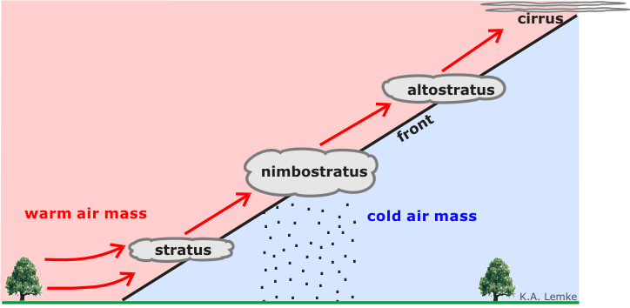

Fronts and their Movement
Warm Front
Hint: Look like little sunshine's on a string.
Notes:
Warm Front. Although both cold fronts and warm fronts can exist without the associated low-pressure cell, the condition is not common. Therefore, the usual warm front is connected to a low-pressure cell, extends eastward from it and travels northeastward. Now, if the low-pressure cell did not move, the warm front would travel counterclockwise around the cell until it dissipated. However, the normal cold-front, low-pressure cell, warm-front complex involves movement of all three components; thus, the low-pressure cell tends to travel eastward/ northeastward across the United States, taking the warm front with it. Since warm air is less dense than cool or cold air, the leading edge of a warm front slips upward and over the cooler air forming a wedge shape. The warm air rises slowly and its rate of cooling is slow, which results in delayed condensation of the water vapor. The approaching warm front is announced by the appearance of cirrus (high, thin, wispy clouds). The cirrus may be as much as 1,000 miles in advance of the front. As the front approaches, other types of clouds are present and the sky gets darker and darker. Eventually, rain begins to fall.
The above description of an approaching warm front is typical. However, fronts do not always act in this typical manner. For instance, a warm front may also cause violent thunderstorms, if the air in front of it is highly unstable. The atmospheric conditions ahead of and behind fronts are key in determining what kind of weather will occur.

Slide 8
Fronts and their Movement
Warm Front Characteristics
  Slow moving 10-25 mph
  Slope slides over cold front due to warmer air aloft, eventually pushing cold air out
  As warm air is lifted, temperature drops and precipitation forms – usually light and continuous
  Higher level cirrus and stratus clouds develop ahead of the front
  Visibility is generally poor but improves after frontal passage with a wind shift
  Winds are from the south to southwest

Slide 9
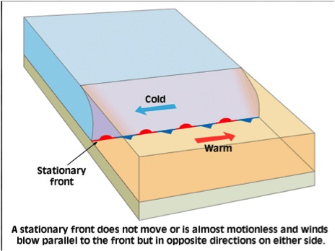

Fronts and their Movement
Stationary Front
Stationary Front Characteristics
  Typical mixture of weather found in both warm and cold fronts
  Winds blow in opposite directions parallel to the frontal boundary line
  Greatest hazard is flooding since the front does not move
Notes:
Stationary Front. When air masses lose their “punch” and are not replacing one another, a stationary front develops. The weather along a stationary front can be very bad for aviation. In parts of the country where there is a large amount of moisture, just about every form of weather can be found along the stationary front. There may be very slow-moving thunderstorms at some locations. At other locations, there may be large areas of drizzle and fog.

Slide 10
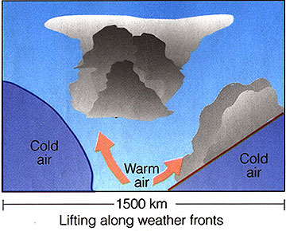
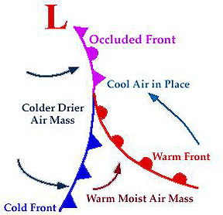
Fronts and their Movement
Occluded Front
Occluded Front Characteristics
  Cold front occlusion
    Fast moving cold front air is colder than the air of the cold air that is ahead of the warm front
    Provides a mixture of weather that can be found in both warm and cold fronts
  Warm front occlusion
    Air ahead of the warm front is colder than the air in the fast moving cold front that is behind the warm front
    Produces some of the most sever weather with embedded thunderstorms, rain and fog
Notes:
Occluded Front. Another type of frontal development is called an occlusion or occluded front. It is formed when a warm air mass, lying between two cold air masses, is lifted up by the cold air mass behind it. The rapidly lifted warm air cools and creates a low sometimes causing severe precipitation to occur. Such a front will also cause the usual cold-front and warm-front weather. As the occluded front passes, there is little change in the temperature of the ground air, because at that level, there is only a change of cold air masses.

Slide 11

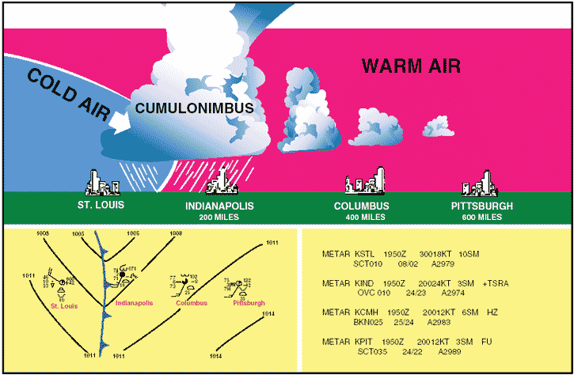
Fronts and their Movement
Advancing cold front

Slide 12
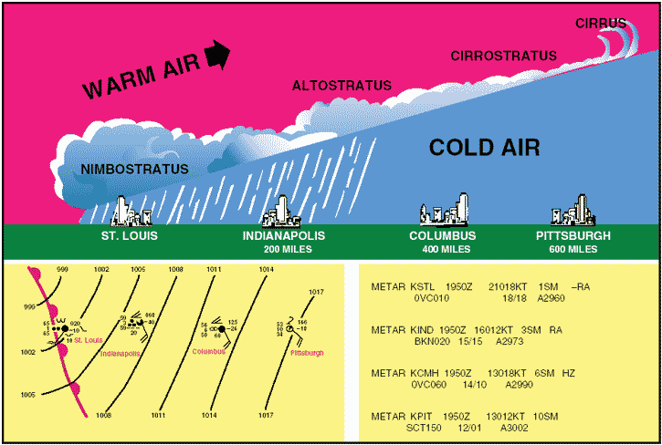
Fronts and their Movement
Advancing warm front

Slide 13
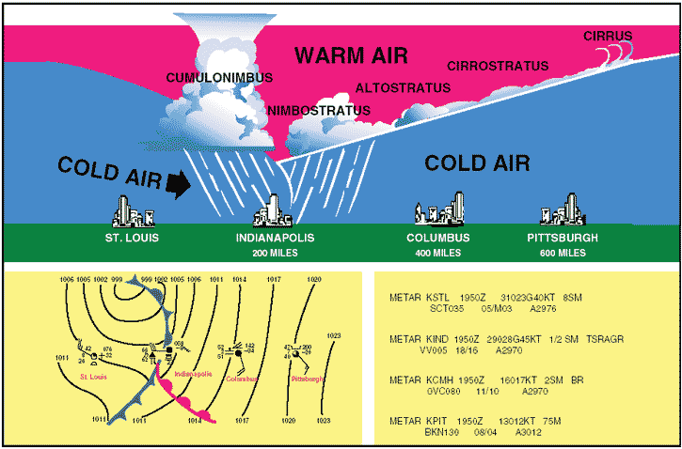
Fronts and their Movement
Occluded front

Slide 14



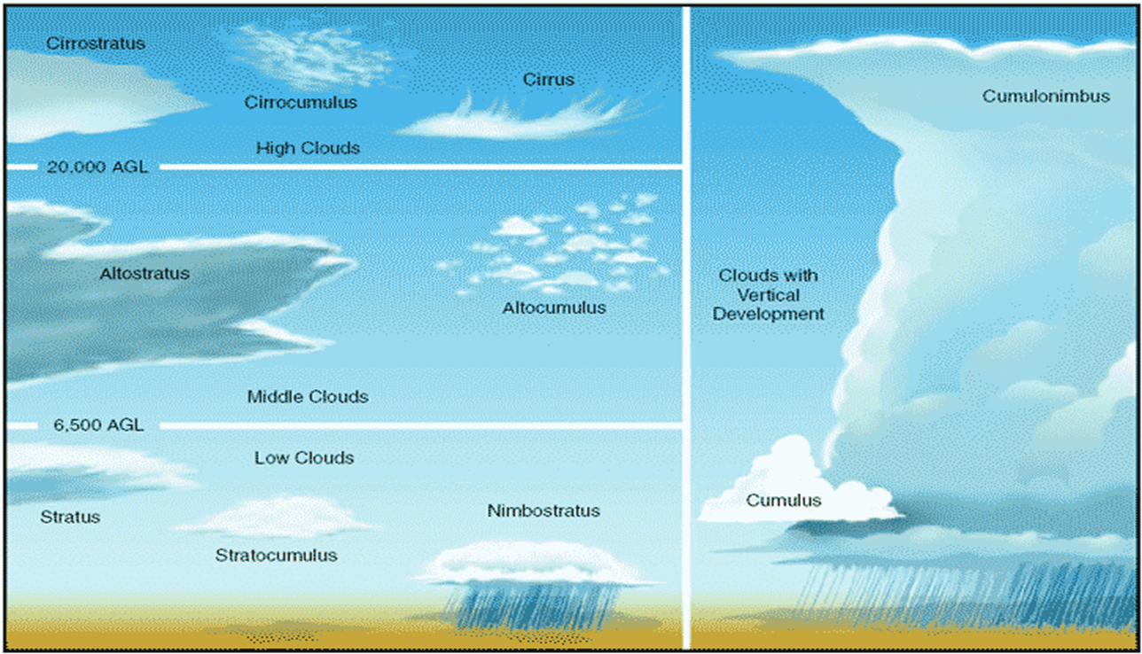
Clouds and Fog
Cloud Types
Cumulous – puffy and piled up
Cirrus – curly and fibrous very high
Stratus – flat and layered
Nimbo (or Nimbus) – rain or precipitation
Alto – high (actually middle clouds – NOT the highest)
Notes:
Cloud Types
The three general types of clouds are cumulus (piled up), stratus (layered), and cirrus (high, thin appearance). All other types come from these three, and we usually talk about them as low, middle and high clouds.
Stratus and Altostratus
Stratus has a smooth appearance. It indicates to pilots that no turbulence (bumpiness) is associated with the cloud. However, the stratus may be nothing more than fog that has developed at the surface and risen a hundred or so feet above the surface. The stratus may or may not produce some type of precipitation. If precipitation does occur, it will be light drizzle in the summer or light snow in the winter. The reason why simple stratus produces so little precipitation is that it is relatively thin. For a cloud to produce significant precipitation, a thickness of 4,000 feet or more is the norm.
Stratocumulus
The similarity of stratocumulus to stratus lies in the layering characteristic only. This cloud has numerous bumps on the topside and usually is rather thick. Heavier rains and snow can be expected from this type of cloud. Turbulence of varying intensity can also be expected nearer the bottom of the layer. To pilots, the appearance of stratocumulus is a warning that flying under these clouds most likely will bring low visibility and probably strong turbulence. Flying over these clouds is not wise either. The stratocumulus can mask higher and more severe cloud buildups.
Cumulus with Vertical Growth
Cumulus alone has a harmless, puffy, cotton-ball appearance with a horizontal dark base. It is known as fair-weather cumulus. It develops from thermals or updrafts of heated air containing a relatively small amount of water vapor. Upon reaching the dew point temperature at altitude, the vapor condenses and forms a small cloud; since no more vapor is available or the thermal dissipates, the cumulus does not grow. Flight below fair-weather cumulus can be rather bumpy because the airplane flies into the updrafts beneath the clouds. However, no danger is involved—just the slight discomfort of a choppy flight. Therefore, aviators find it better to climb above such clouds and enjoy a smooth ride. However, cumulus with vertical growth, or
Building cumulus, deserves attention. It will produce at least a strong rain shower with moderate to severe turbulence. Chances are it will develop into a thunderstorm.
Vertical-growth cumulus can be expected if the relative humidity is high, the temperature is hot, and the air is unstable. Thus, the spring and summer months are the best times for this type of cloud buildup. Very strong updrafts are characteristic
of these clouds as they build higher and larger. As conditions become more favorable, two or more clouds will merge and form an even larger cell from their combined energies. This type of growth continues until the cloud becomes a cumulonimbus. As a cumulonimbus, it has developed precipitation along with thunder and lightning. With further building and increase in intensity, the cumulonimbus is called a thunderstorm.

Slide 15
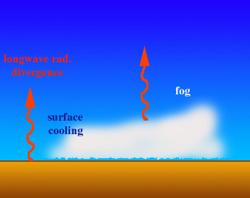
Clouds and Fog
Radiation Fog
Warmer moist air
Air cools by conduction as it reaches the cool ground
Cool land surface
Notes:
Fog Types
Fog is a surface-based cloud because it develops within the atmosphere. It is considered separate of clouds because of how it is formed. It is a cloud in contact with the ground. There are five types of fog: radiation, high-inversion, advection, evaporation and upslope.
Radiation fog is so named because it forms at night when land surfaces radiate much of the heat absorbed from the sun back into space. The cool land surface in turn cools the air near it (by conduction) to below the dew point and fog is formed. High-inversion fog is actually a low cloud; it is formed by condensation of water vapor at or near the top of cool air that is covered by a warmer air layer.

Slide 16
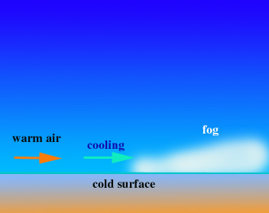
Clouds and Fog
Advection Fog (remember advection = lateral movement)
Air temperature reaches dew point and fog forms
Warm moist area
Air move laterally until it touches cold surface
Notes:
Advection fog is formed when wind blows moist air over a cold surface and the surface cools the air to its dew point temperature. Evaporation or steam may occur when cold air moves over warm water; the water’s normal evaporation process saturates the cooler air with water vapor, and the dew point is reached. Upslope fog results when wind carries moist air up a mountain slope or sloping land until the air is cooled.

Slide 17
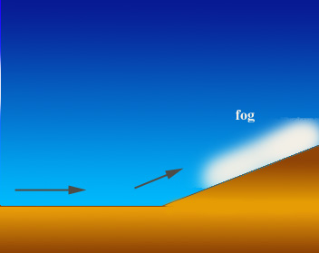
Clouds and Fog
Up-slope Fog
The air cools as it ascends until it reaches dew point and fog forms
Warm, moist air blows up the hill side
Notes:
As the air mass enters the United States, the mountains cause it to rise. As it rises, it cools and loses practically 100 percent of its moisture on the western slopes of the mountains in the form of snow. This accounts for the excellent ski conditions. As it descends the eastern slopes, this dry air is heated and absorbs the small amount of moisture in the vicinity of Death Valley. This process is repeated again and again all over the world in the Himalayas, the Alps, the Caucasus and other mountain ranges where windward (facing the wind) slopes are moistened with rain and snow, and where leeward slopes are dry. Along many seacoasts, there is a breeze from the sea by day. This moist, relatively cool air rises and heats as it passes across land. Clouds form a short distance inland and may bring showers by afternoon. At night, the land cools more rapidly than the sea, the current is reversed and the breeze blows from land to sea.
Wind blowing toward, or with, land formations that slope gently upward carries moisture-laden air to the altitude where its dew point temperature is located and condensation can occur. The reverse can happen if the wind forces clouds, which have already formed, downward into warmer air. The clouds will again become water vapor.

Slide 18
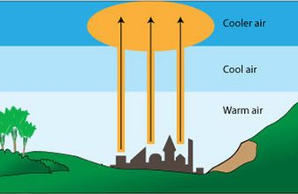
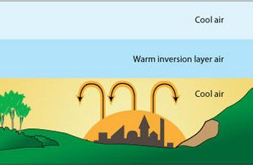
Clouds and Fog
Temperature inversion – the basics
Temperature inversion occurs when cold, dense air replaces the warm air at a rapid rate and traps a layer of warm air between 2 cooler layers
Normally, heat radiates upwards and is cooled as it ascends about 3.5° F/1000’

Slide 19
Clouds and Fog
High-inversion fog
Warm, moist air layer is trapped
Cool air cools the moist air to the dew point and fog forms
Cold, dense air rushes down the hillside

